Slide 1
Real-time Anomaly Detection over ECG Data Stream based on Component Spectrum
Jorfun

Slide 2
目录
解决的问题
背景知识
方法概要
方法详细介绍
component spectrum representation module(CSRM)
latent class clustering module(LCCM)
classification-based anomaly detection module(CADM)
Online Processing
方法效果评估
个人观点

Slide 3
Detecting anomalies in ECG data streams
Recently, researches on detecting anomalies and outliers have drawn increasing attention. As regard of ECG data streams, however, detecting anomalies is confronting with four major challenges.
Poor Data Quality
Pseudo-periodicity
High Data Volume
High Real-time Requirement

Slide 4
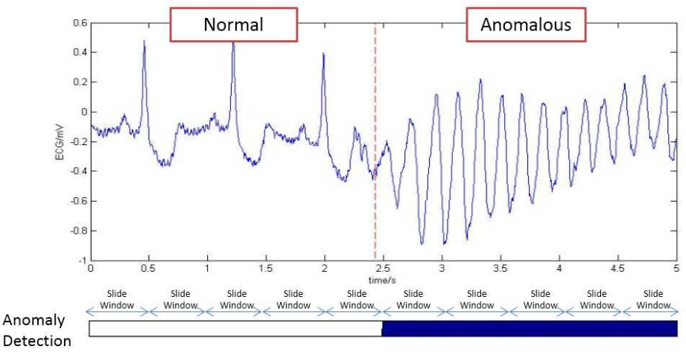
Notes:
An example of ECG data stream. The anomaly detection algorithm outputs whether the data of the current slide window is anomalous. In this figure, the anomalous part is painted blue.

Slide 5
目录
解决的问题
背景知识
方法概要
方法详细介绍
component spectrum representation module(CSRM)
latent class clustering module(LCCM)
classification-based anomaly detection module(CADM)
Online Processing
方法效果评估
个人观点

Slide 6
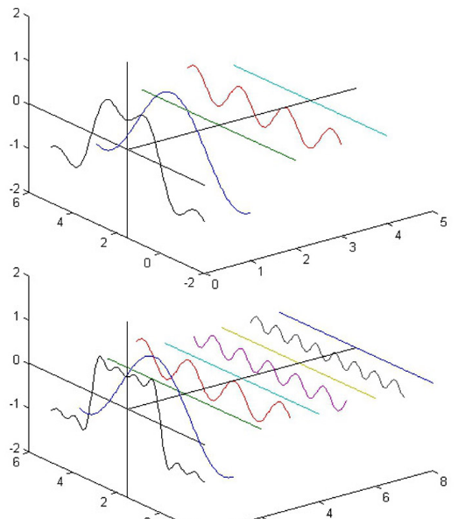
任何波形都是可以用正弦波叠加起来得到的。
不同频率的正弦波我们成为频率分量。

Slide 7
相关概念
A given function or signal can be converted between the time and frequency domains with a pair of mathematical operators called a transform. An example is the Fourier transform, which converts the time function into a sum of sine waves of different frequencies, each of which represents a frequency component. The 'spectrum' of frequency components is the frequency domain representation of the signal. The inverse Fourier transform converts the frequency domain function back to a time function

Slide 8
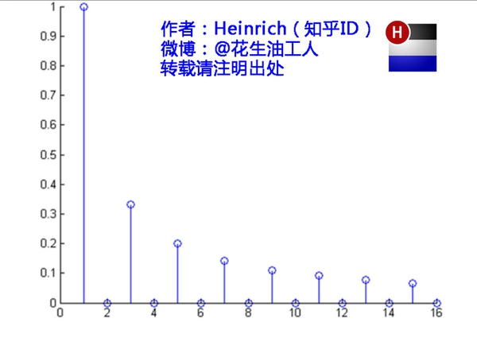

Slide 9
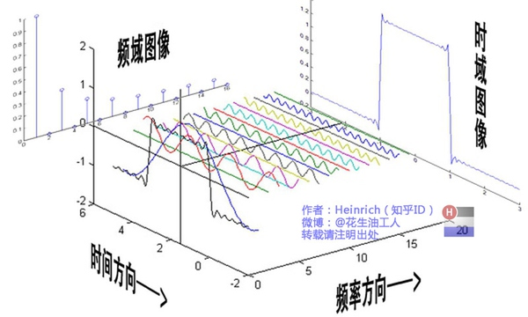

Slide 10
目录
解决的问题
背景知识
方法概要
方法详细介绍
component spectrum representation module(CSRM)
latent class clustering module(LCCM)
classification-based anomaly detection module(CADM)
Online Processing
方法效果评估
个人观点

Slide 11
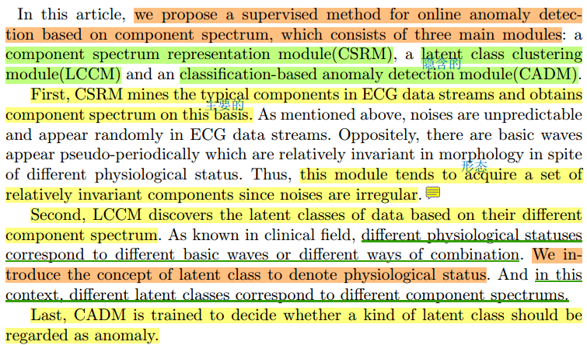

Slide 12
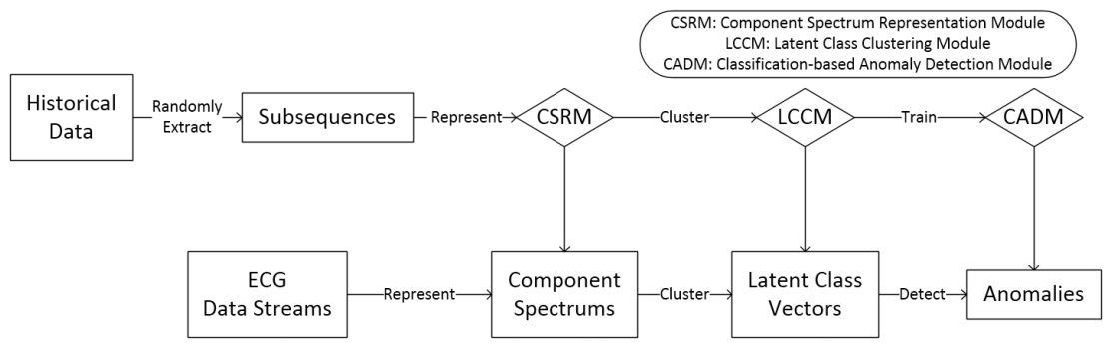
The parameters of the three modules are trained beforehand using the historical data of the same kind, so the method can be processed online.

Slide 13
目录
解决的问题
背景知识
方法概要
方法详细介绍
component spectrum representation module(CSRM)
latent class clustering module(LCCM)
classification-based anomaly detection module(CADM)
Online Processing
方法效果评估
个人观点

Slide 14
component spectrum representation module(CSRM)
The goal of CSRM is to represent the subsequences as the linear combination of a small amount of typical components. And the training task here is to acquire the component set.

Slide 15
component spectrum representation module(CSRM)
Noises are unpredictable and appear randomly in ECG data streams. Oppositely, there are basic waves appear pseudo-periodically which are relatively invariant in morphology in spite of different physiological status. Thus, this module tends to acquire a set of relatively invariant components since noises are irregular.

Slide 16
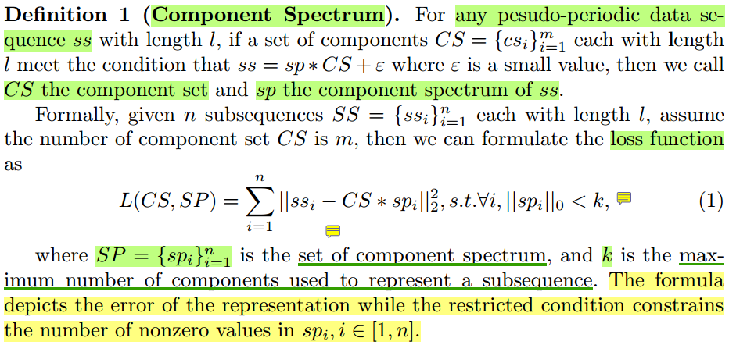
component spectrum representation module(CSRM)

Slide 17
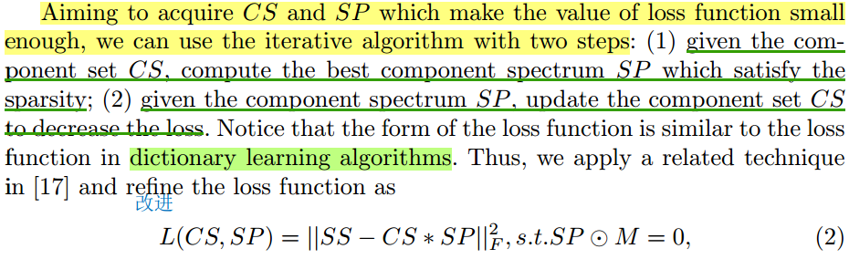
component spectrum representation module(CSRM)

Slide 18
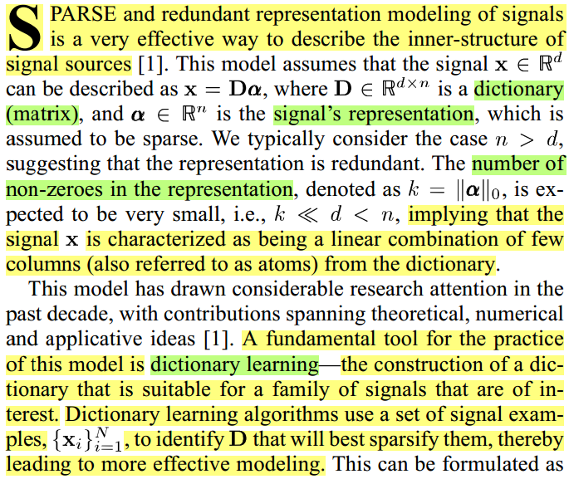
Dictionary
Learning

Slide 19
目录
解决的问题
背景知识
方法概要
方法详细介绍
component spectrum representation module(CSRM)
latent class clustering module(LCCM)
classification-based anomaly detection module(CADM)
Online Processing
方法效果评估
个人观点

Slide 20
Topic Model (主题模型)
LDA由Blei, David M.、Ng, Andrew Y.、Jordan于2003年提出，是一种主题模型，它可以将文档集 中每篇文档的主题以概率分布的形式给出，从而通过分析一些文档抽取出它们的主题（分布）出来后，便可以根据主题（分布）进行主题聚类或文本分类。同时，它是一种典型的词袋模型，即一篇文档是由一组词构成，词与词之间没有先后顺序的关系。此外，一篇文档可以包含多个主题，文档中每一个词都由其中的一个主题生成。
人类是怎么生成文档的呢？LDA的这三位作者在原始论文中给了一个简单的例子。比如假设事先给定了这几个主题：Arts、Budgets、Children、Education，然后通过学习的方式，获取每个主题Topic对应的词语。如下图所示：

Slide 21
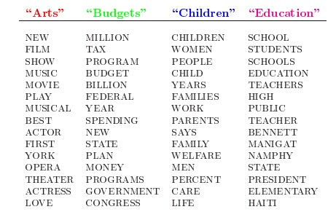

Slide 22
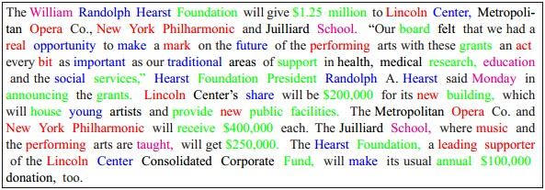
Topic Model (主题模型)
然后以一定的概率选取上述某个主题，再以一定的概率选取那个主题下的某个单词，不断的重复这两步，最终生成如下图所示的一篇文章（其中不同颜色的词语分别对应上图中不同主题下的词）：

Slide 23
Topic Model (主题模型)
而当我们看到一篇文章后，往往喜欢推测这篇文章是如何生成的，我们可能会认为作者先确定这篇文章的几个主题，然后围绕这几个主题遣词造句，表达成文。LDA就是要干这事：根据给定的一篇文档，推测其主题分布。
通俗来说，人类根据上述文档生成过程写成了各种各样的文章，现在某小撮人想让计算机利用LDA干一件事：你计算机给我分析推测网络上各篇文章分别都写了些啥主题，且各篇文章中各个主题出现的概率大小（主题分布）是啥。

Slide 24
latent class clustering module(LCCM)
The task of LCCM is clustering the component spectrums to associate them with different phenotypes, and obtaining the latent class vector as the quantized association strength.
得到关于一段subsequence的latent class vector，该vector用量化的形式表示了该subsequence与每种latent class的关联强度。

Slide 25
latent class clustering module(LCCM)
It is known that different phenotypes of ECG data root in different statuses of cardiac electrophysiological activities. If we divide the statuses into several types, then each type is associated with a particular combination mode of a series of typical components.
把ECG数据的产生过程看下如下的形式(主题模型): 以一定的概率选取一或多个type(cardiac electrophysiological activities statuses)，再以一定的概率选取相应type中对应的components。
一个sliding window(subsequence)对应的Latent class vector表示该sliding window对应各种phenotype出现的可能性

Slide 26
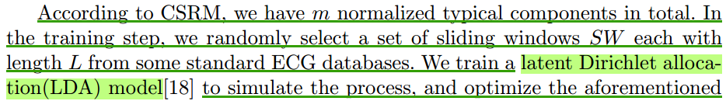
latent class clustering module(LCCM)
LDA的作用：给定一个sliding window(subsequence)，推测其表现型分布(出现各种表现型的可能性)

Slide 27
目录
解决的问题
背景知识
方法概要
方法详细介绍
component spectrum representation module(CSRM)
latent class clustering module(LCCM)
classification-based anomaly detection module(CADM)
Online Processing
方法效果评估
个人观点

Slide 28
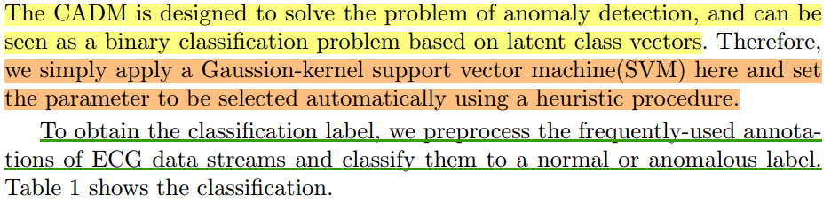
classification-based anomaly detection module(CADM)

Slide 29
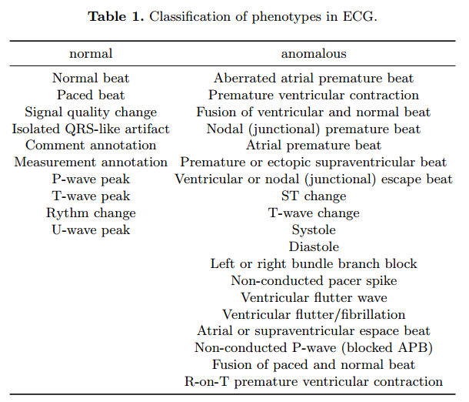

Slide 30
目录
解决的问题
背景知识
方法概要
方法详细介绍
component spectrum representation module(CSRM)
latent class clustering module(LCCM)
classification-based anomaly detection module(CADM)
Online Processing
方法效果评估
个人观点

Slide 31
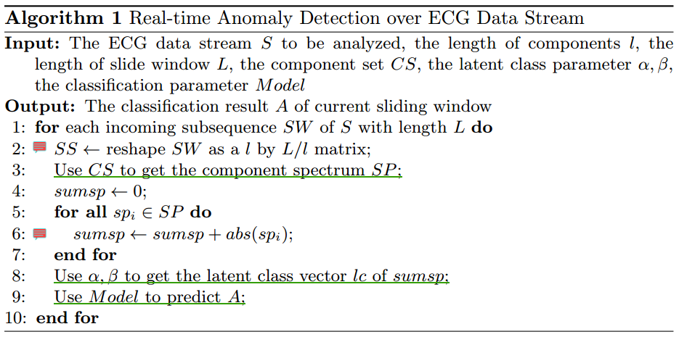
Online Processing

Slide 32
目录
解决的问题
背景知识
方法概要
方法详细介绍
component spectrum representation module(CSRM)
latent class clustering module(LCCM)
classification-based anomaly detection module(CADM)
Online Processing
方法效果评估
个人观点

Slide 33
个人观点
迫于会议的篇幅限制无法讲清楚？
文章中概念多，很多含义相近，却不规则地出现在文章各个部分，很不方便读者理解。（sliding window，subsequence，sequence | phenotype，statuses of cardiac electrophysiological activities）
花了大量精力去理清概念之间的关系，去文章之外的地方查找相关资料去方便理解。
实验评估：在线与非在线的方法比较？
其他细节

